Slide 1
Fine-tuning a model based on 2000 drug examples
Jubaida Tasnim

Slide 2
Table of Contents
Introduction
Design
Implementation
Test
Results
Enhancement Ideas
Conclusion

Slide 3
Introduction
Brief overview of the project: Fine-tuning a model based on 2000 drug examples to classify drug indications.
Purpose: Explain why fine-tuning is necessary for drug classification tasks.

Slide 4
Design - Identifying and Understanding the Problems
Problem Identification:
Challenge of identifying maladies based on drug names.
Need for structured data in a format suitable for model fine-tuning.
Understanding the Issue:
Importance of accurate malady classification in healthcare applications.

Slide 5
Design - Investigating Possible Solutions
Explored Approaches:
Considered fine-tuning models such as gpt-3.5-turbo-0125 for cost-effectiveness and efficiency.
Need to convert raw drug data into a machine-readable JSONL format for fine-tuning.
Chosen Solution:
Structured data in a prompt-completion format, with maladies assigned unique identifiers.

Slide 6
Design - Comparing Solutions and Selecting the Best One
Comparison of Options:
Experimented with model and data configurations to achieve high classification accuracy.
Final Decision: Use a prompt-completion format with single-token classifications for efficiency.
Advantages of the Chosen Solution:
Cost-effective.
Suitable for classification using a fine-tuned model.

Slide 7
Implementation - Preparing the Data
Step 1: Data Preparation
Conversion of XLSX data to JSONL format using Python and Pandas.
Example format: {"prompt": "Drug: <DRUG NAME>\\nMalady:", "completion": " <MALADY ID>"}
Assign unique identifiers to each malady (e.g., Acne: 0, Apnea: 1).
Key Points:
"\nMalady:" separator in prompts.
Single-token completions for efficient classification.

Slide 8
Implementation - Command to Prepare Data
Step 2: Data Preparation Command
Command: openai tools fine_tunes.prepare_data -f drug_malady_data.jsonl
Explanation: Analyzes data for format and consistency, and splits into training/validation if prompted.

Slide 9
Implementation - Command to Train the Model
Step 3: Training the Model
Command:
openai api fine_tunes.create \
-t "drug_malady_data_prepared_train.jsonl" \
-v "drug_malady_data_prepared_valid.jsonl" \
-m gpt-3.5-turbo-0125 \
--suffix "drug_malady_data"
Notes:
Model: gpt-3.5-turbo-0125 for cost-effectiveness.
Suffix: “drug-malady-data” for model identification.

Slide 10
Implementation - Checking Job Progress
Step 4: Monitor Progress
Command: openai api fine_tunes.follow -i <JOB ID>
Usage: To check job status and ensure training completes successfully.

Slide 11
Test - Testing the Fine-Tuned Model
Step 5: Testing the Model
Python code to test fine-tuned model with sample drug names.
Example code snippet provided for generating predictions.

Slide 12
Test - Explanation of Code
Testing Explanation:
Describe how each drug is classified into a malady class.
Example:
Input: Drug name prompt.
Output: Predicted malady class based on fine-tuning.
Using Class Mapping:
Maps numeric class outputs to malady names for interpretability.

Slide 13
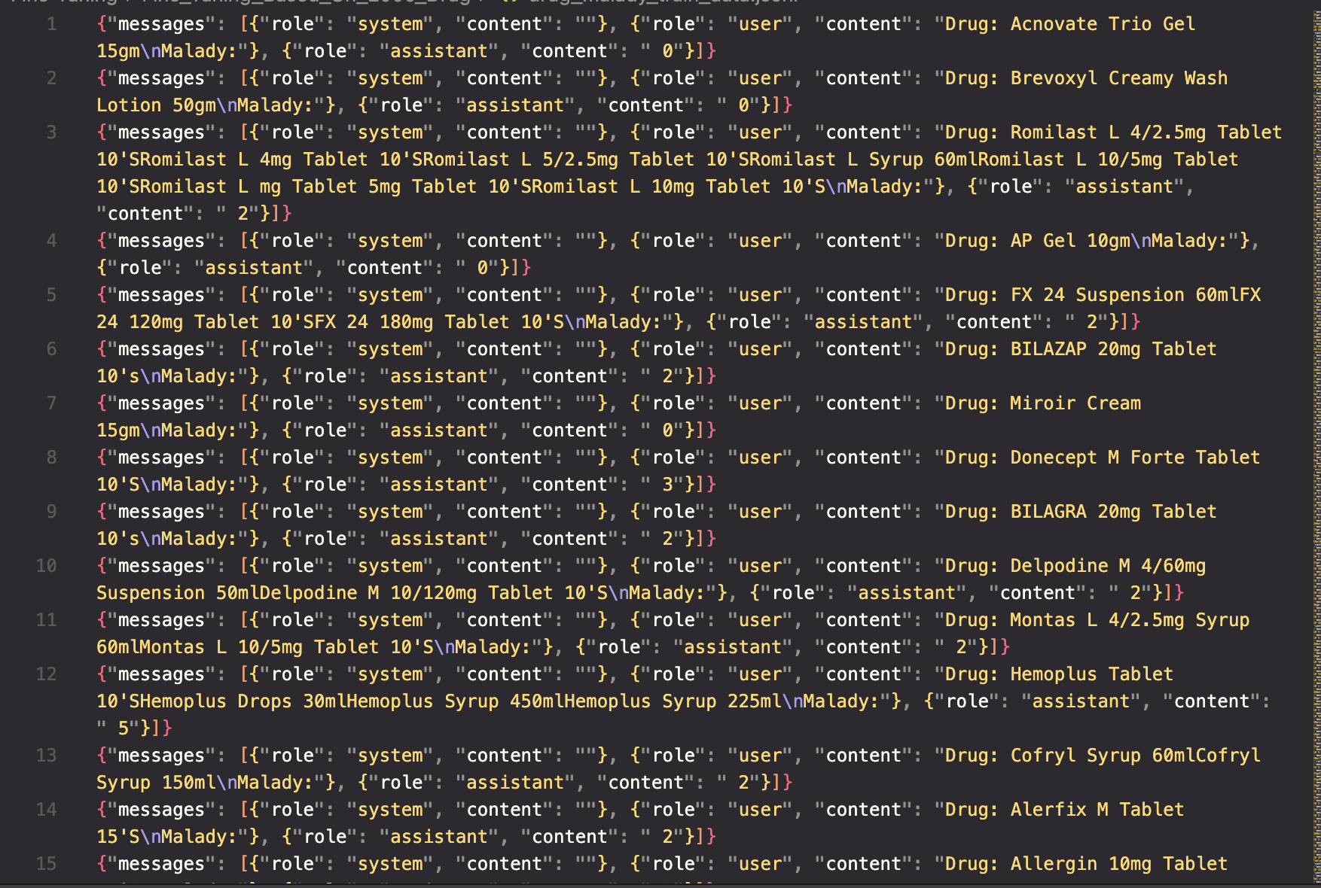
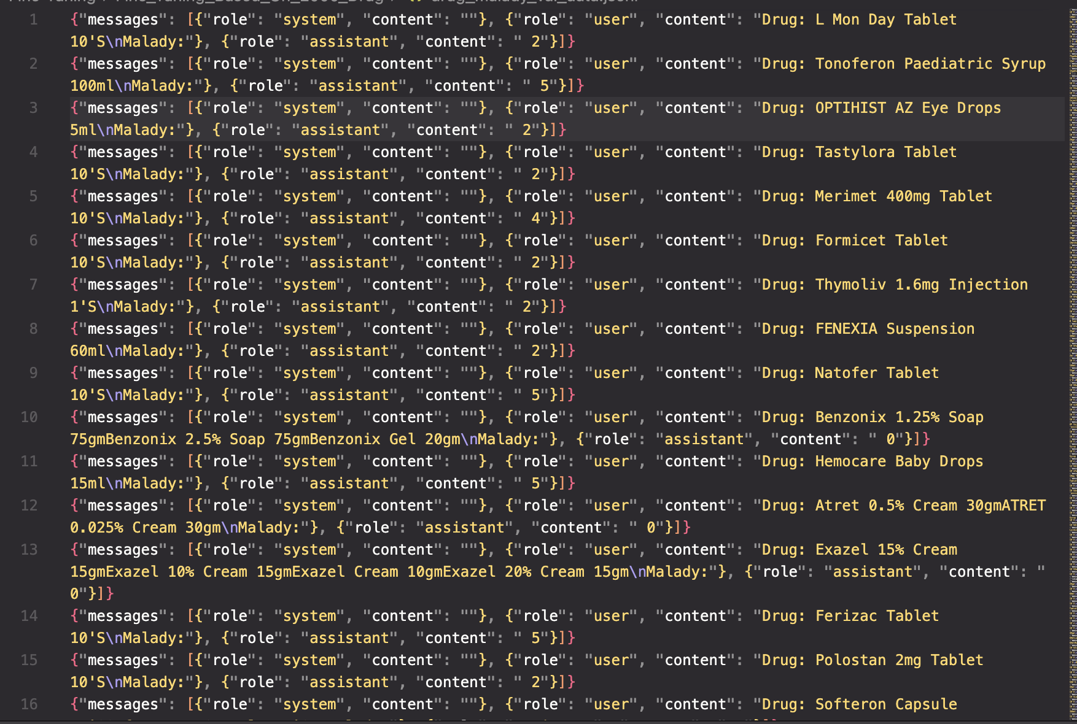
Results

Slide 14
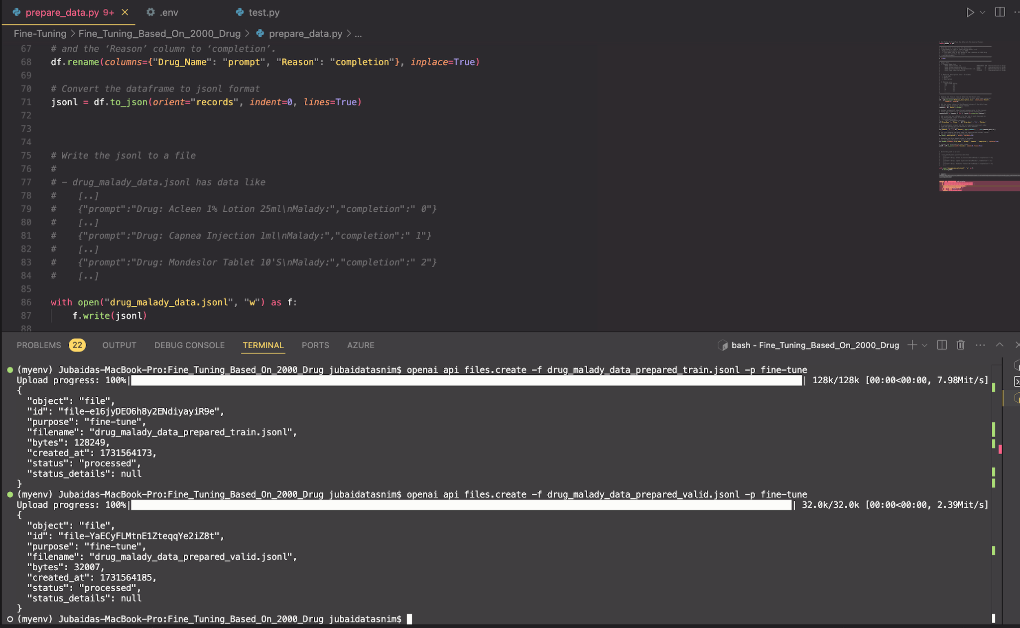

Slide 15
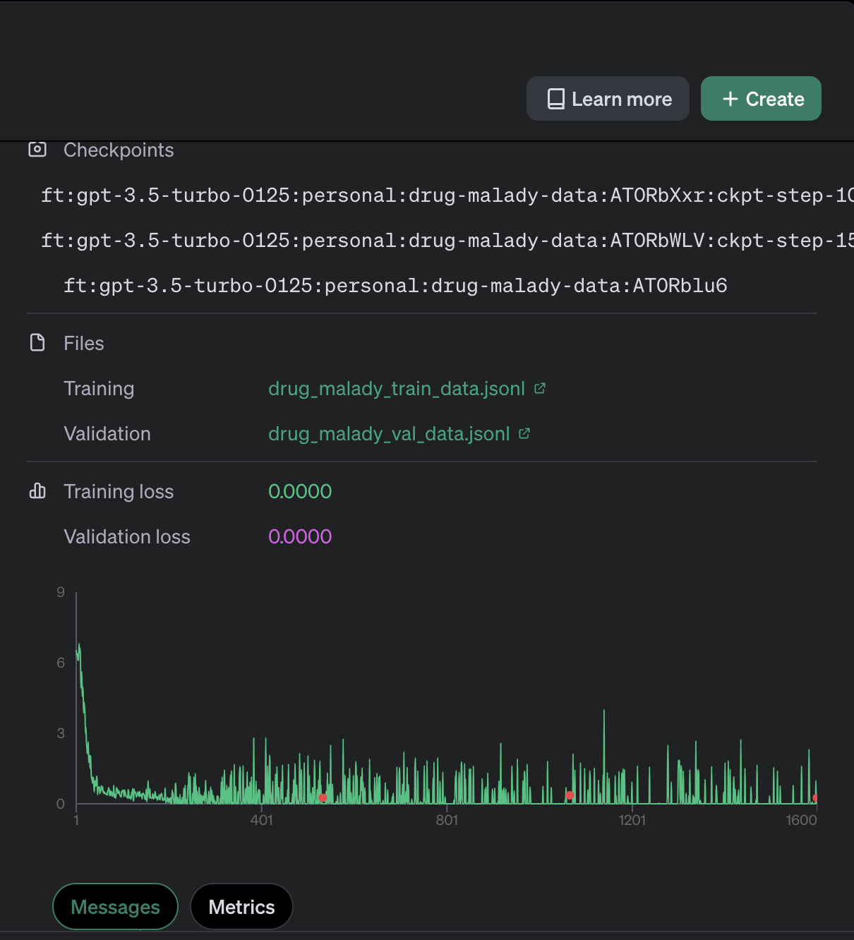
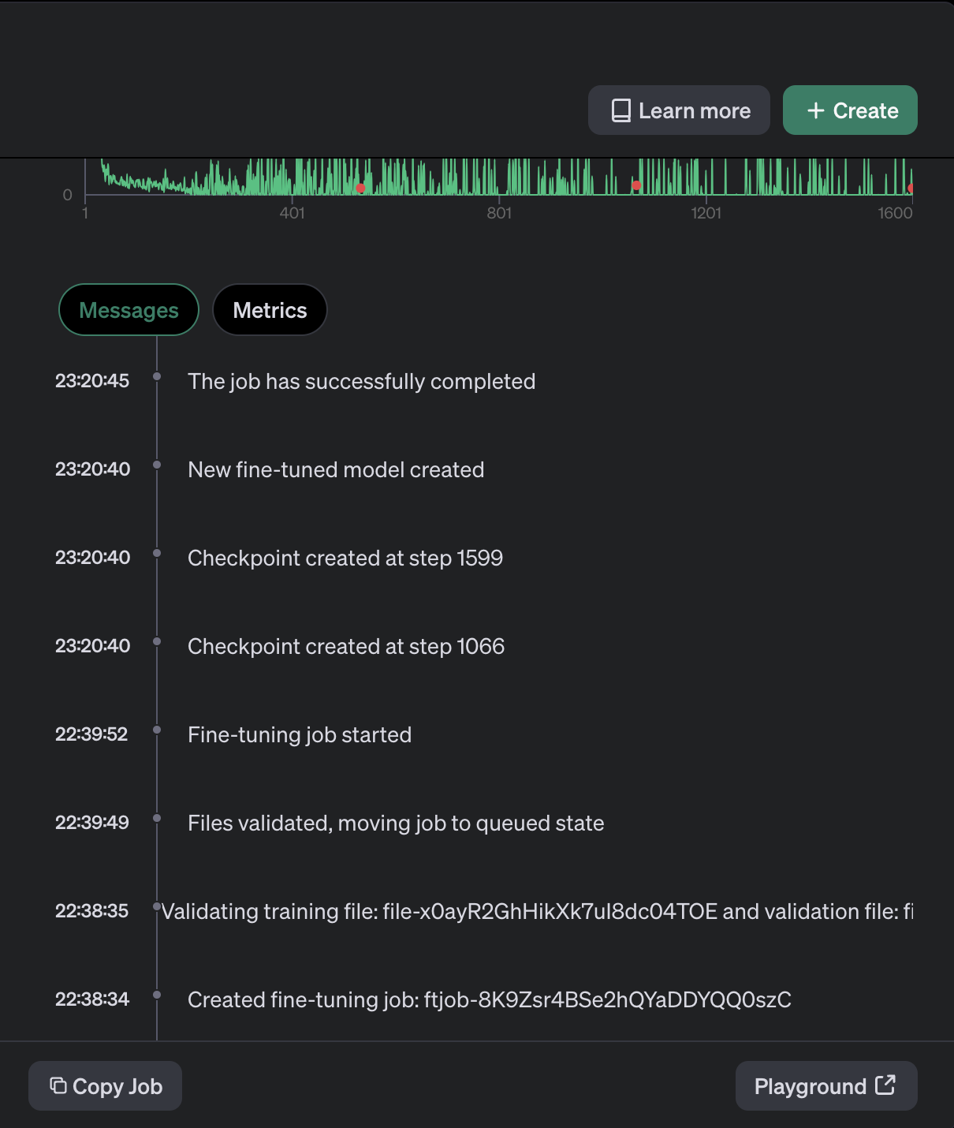

Slide 16
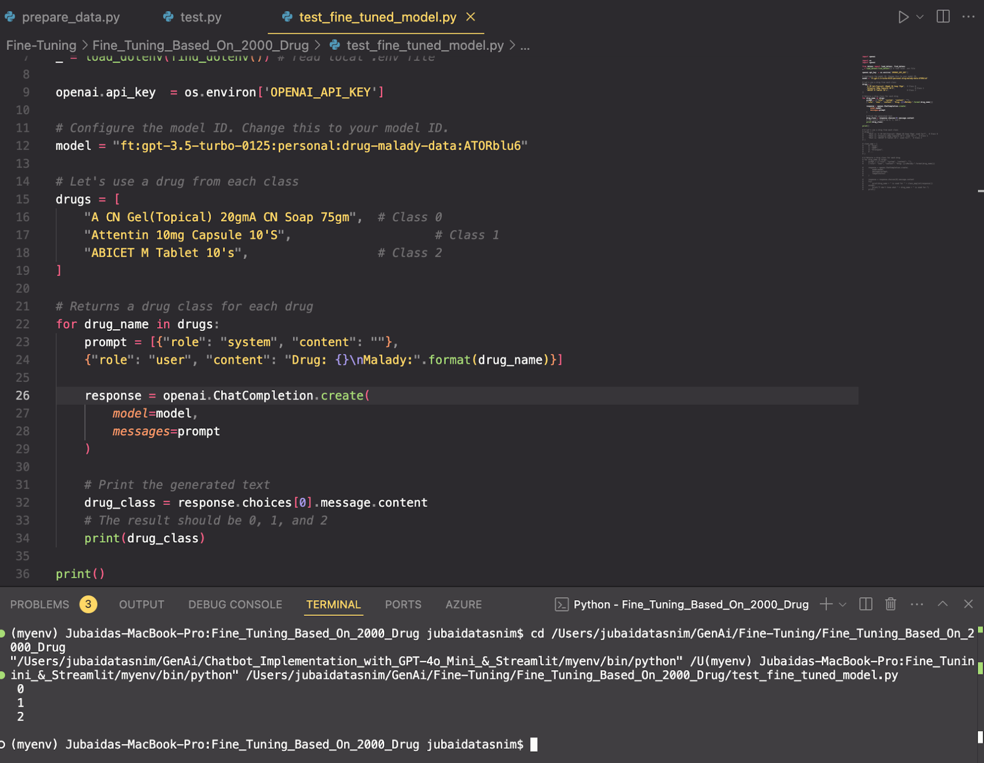

Slide 17
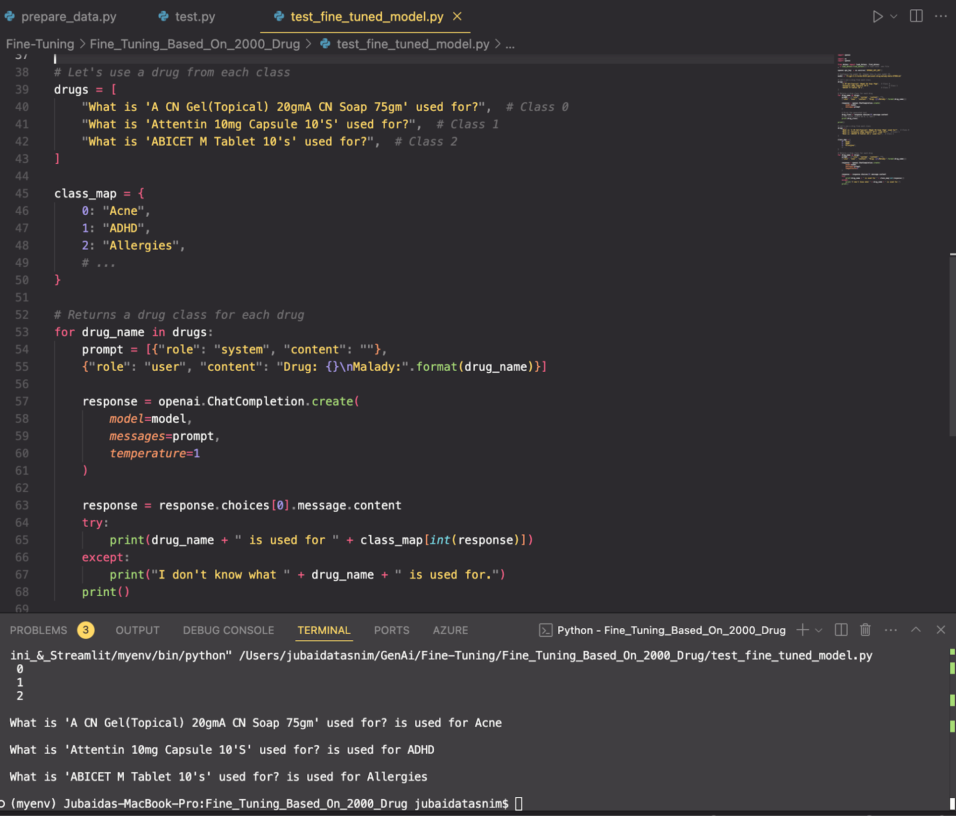

Slide 18
Enhancement Ideas
Future Improvements:
Expand dataset for more diverse drug classes.
Experiment with larger models for better accuracy.
Add more detailed classifications within each malady category.

Slide 19
Conclusion
Summary:
Fine-tuning approach for drug classification.
Achievements: Cost-effective, reliable model for drug-malady prediction.
Next Steps:
Explore real-world application of the model in healthcare systems.

